Slide 1
Draft Concept Report
University of Alcalá

Slide 2
Introduction
Project plan:
Draft concept is only possible after collecting the information from stakeholders and approving the conclusions
Consultations, Online survey, Interviews
Other requirements come from general considerations in the project proposal
Also as logical consequences of efficiency and adaptation to situation
Focus on QA not in general management of centres
Delay:
Surveys were delayed (results: April 2016, consultations reports: March 2016, consistency analysis: done by UAH)
Beginning of May 2016: draft concept to IT Study to start create prototype. UAH prototype for consultation (Jan-Feb 2016)

Slide 3
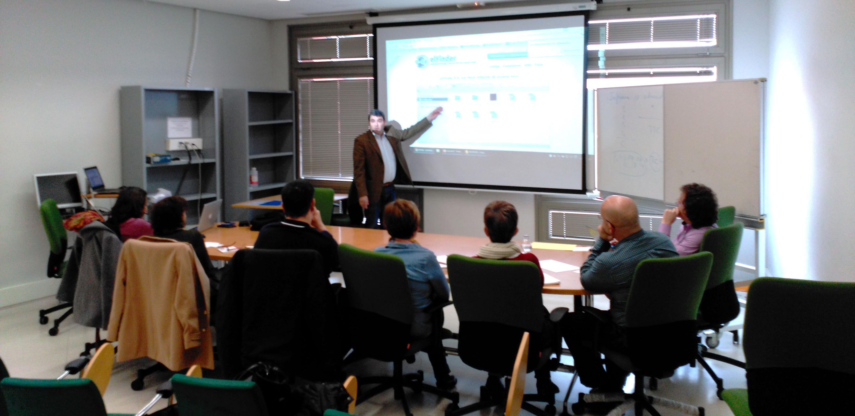
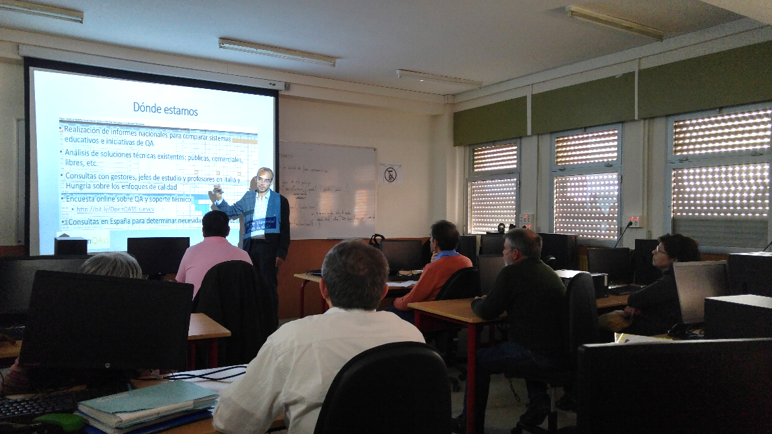
E6 Consultation
3 sessions, visiting 3 locations/centres
Public, semi-public and private (6 schools)
32 participants (evidences), report

Slide 4
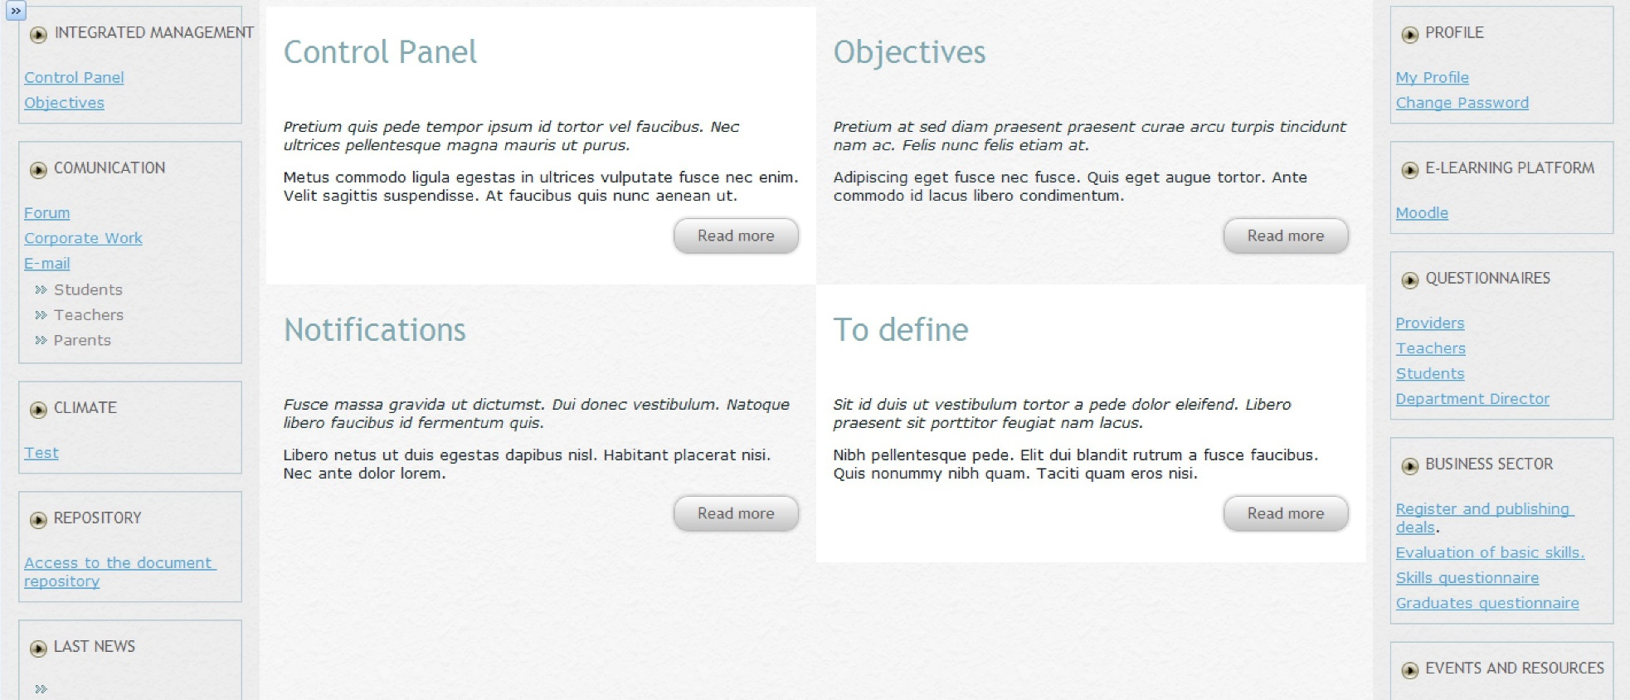
E6 on design (I)
Using UAH prototype

Slide 5
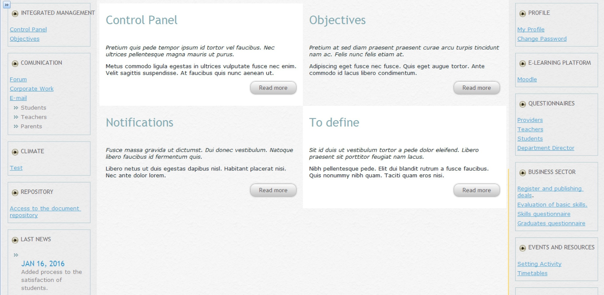
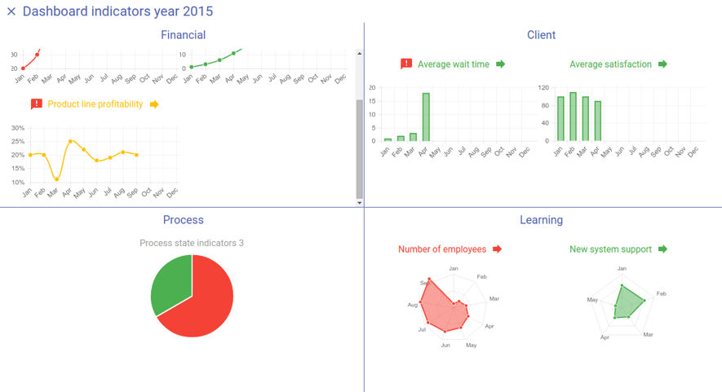
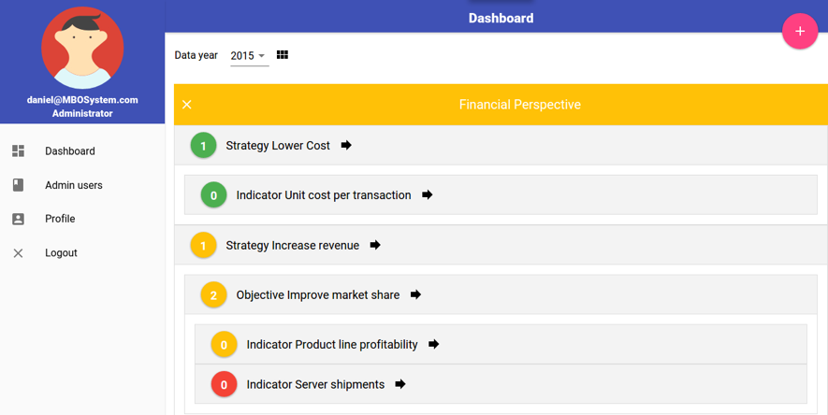
E6 on design (II)
Using UAH prototype

Slide 6
Resources for System concept
System in practice of the European VET institutions
National reports - review implementation of EQAVET in partner countries.
Identify best practices of QAs in European VET providers
Review existing ICT supported QA Solutions.
Teachers’ Requirements for Open QAsS – Study
Implement multilingual platform for online collaboration.
Online consultation with VET teachers and trainers.
Online survey and statistical analysis will direct the activities.

Slide 7
Practical suggestions based on interviews and comments
1. Design focus on common components of QA for all countries
2. Modular design:
Meet different QA requirements
Dynamism of VET with changing QA regulations and criteria
3. Modular implementation and open source.
4. Implementation of adapted open source existing solutions (not reinvent the wheel)
5. User-centred design: awareness about QA in education.
6. Exemplary IT-based solutions: inspiring source.
7. Not increase the administrative workload of the teachers
8. Cloud centralized environment: if possible only an internet connection and a browser
9. Single login for using all possible modules.

Slide 8
Processes from online survey

Slide 9
Survey: Hungary

Slide 10
Survey: Italy

Slide 11
Survey: Ireland

Slide 12
Survey: Spain

Slide 13
Processes selected: survey
Planning of learning activities.
Learning activity.
Attainment of learning objectives, exam results, individual student progress relative to their baseline standard.
Teacher’s reflection on progress and the effectiveness of their approach.
Professional development and motivation of staff.
Strategic direction, leadership and planning.
Measurement of teachers' satisfaction.
Measurement of students' satisfaction.

Slide 14
Comparative of processes according to suggestions
Processes Hungarian Suggestions | Hungarian | Italian | Irish | Spanish
Planning of learning activities Event managements (workshops for talents) | X
Learning Activity Supporting the teaching-learning process Document repository Supporting inside flow communication | X | X | X | X
Attainment of learning objectives, exam results, individual student progress relative to their baseline standard Document repository Supporting the teaching-learning process | X | X | X | X
Teacher’s reflection on progress and the effectiveness of their approach | X | X
Professional development and motivation of staff Supporting communication Supporting the self-assessment of teachers and headmasters. | X | X | X | X
Strategic direction, leadership and planning Event management (e.g. workshops for talents) | X
Measurement of teacher’s satisfaction Supporting self-assessment of teachers, supporting for quality goals of teachers. Climate test using online tool (e.g. Limesurvey). | X | X | X | X
Measurement of student’s satisfaction Survey module with questionnaires templates in four languages. Support for alumni – placement, after 5 years. Support for follow-up basic skill-test. | X | X | X | X

Slide 15
Selection of processes according to survey results
TOPIC | Hungarian | Italian | Irish | Spanish
Policies and standards | Using exact policy | Tool to adjust policies and standards | Clear definition of standards (external/internal and covering the responsibilities | First determine policies we need to follow to manage quality
Usability | Flexible templates, easy to understand |  | Clear and transparent, easy to use, auto-complete the forms. | Easy to use
Customer satisfaction | Successive questionnaires as evidence of processes | Measuring stakeholder satisfaction |  | Tools for surveys and satisfaction studies
Connecting tools | Interoperability |  | Improve communication | Improve communication among tools: data interlinked
Teaching and learning | Support for teaching - learning | Planning process of teaching and learning | Increase basic training, teaching resources | Tools to improve the teaching and learning process

Slide 16
Selection of processes according to survey results
TOPIC | Hungarian | Italian | Irish | Spanish
Document repository | Online Document Library |  | Consistency of documentation | Document repository, sharing with other teachers
Quality | Software for appropriate quality control | Register control quality in order to improve, models with integral approach to QA | Training in QA existing manager of QA. System roadmap for quality control. | Plan and better manage quality processes, tasks but ignoring general approach
Team work | Working with partners with relevant experience | Teamwork and quality control software | Teamwork | Closer connection/ support among teachers
Help, support | Possibility of a support system easy to use |  | Support, external moderation and advice
Indicators | Processing quality indicators |  | Information to be shared with other institutions for greater continuity | Centres do not have definition of objectives or scorecard.

Slide 17
Selection of processes according to survey results
TOPIC | Hungarian | Italian | Irish | Spanish
Reviews | Revisions of evaluation (PDCA) |  | Review current system, monthly meetings and software to monitor/analyse results | Possibility of reviewing results to make decisions or change things
Application as teachers |  | Reflection of teachers on progress and effectiveness | A better participation in its implementation as teachers
Training |  |  | Require training
Other [no clear relation with other items] | Fresh methods, prioritize, less administration, share experience | Share experiences and practices, improve the use of TIC
Reviews | Revisions of evaluation (PDCA) |  | Reviewing current system, monthly meetings and software to monitor and analyse results | Possibility of reviewing results to make decisions or change things

Slide 18
Other requirements or needs
Common Login
Minimum number of login procedures: centralized and integrated system.
Connected to security of the system: non-functional requirement.
QA Documentation
Essential: supporting QA documentation in the system.
Frequently commented in all countries.
An online QA Manual: easy and permanent access to QA guidelines for action.
Adaptation to situations
Existing solutions for specific functions (even compulsory for centres)
Admin functions to configure solution for each centre

Slide 19
Tools
Process | Activities | Tools
Planning of learning activities Learning activity | Document repository (standard documents, curricula, lesson plans, pictures, figures, exercises, presentations, methods etc.) Supporting the teaching-learning (help to follow the changes during the semester/trimester)
Learning activity | Self-reflection: important component is self-reflections of teachers | Very difficult to structure for all the countries and centres.
Measurement of teacher’s satisfaction. Measurement of student’s satisfaction. Teacher’s reflection on progress and effectiveness | Survey module for feedback Process track, teachers’ portfolios From students’, parents’ fellows, schools leaders. Supporting self-assessment of teachers, supporting for quality goals of teachers. Climate test. Support for follow-up basic skill-test.
Communication | Knowledge sharing. Supporting communication (students, parents , fellows) Cooperation to solve issues
Quality | QA Manual: comprehensive, interactive learning content of institutional QA and management. Like learning material with notes, self-assessment, etc. | Interactive manual

Slide 20
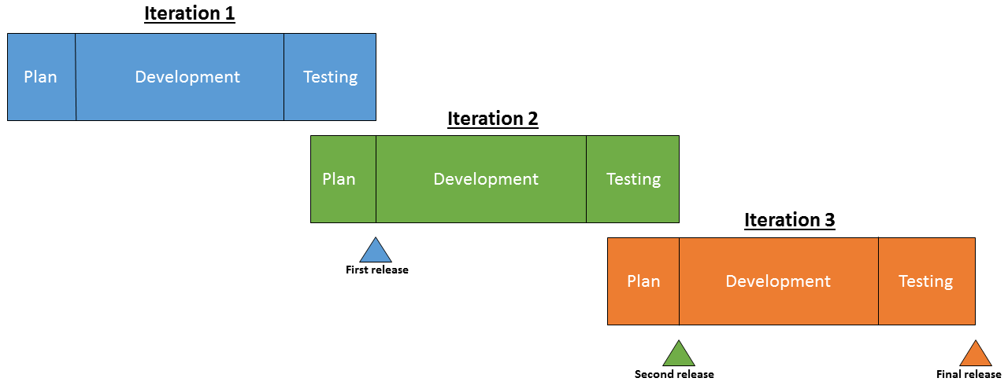
Iterations
Iteration | Tasks
1 | Agreed vision of system and specify the integration architecture for the selected set of tools. Research work and search for resources for common login procedure Common web system architecture, including login, appearance, underlying technology, centralized server support, etc. Prepare, adapt, implement and configure the document repository tool.
2 | Prepare, adapt, implement and configure the module for surveys and questionnaires. Numerous templates for all necessary roles and tasks Prepare, adapt, implement and configure the communication modules including the whole variety of forums, messages, mailing lists, etc.
3 | Prepare, adapt, implement and configure management indicators and goals achievement control with the corresponding customizable scorecard. Prepare, adapt, implement and configure tools required for additional support such as e.g. creating and controlling timetable, coverage areas or self-organization of tasks.
All | Run the iteration test plan, different levels of tests including system and complete acceptance testing (maybe combination of alpha and beta testing)

Slide 21
Quality assurance
Use UML models as main notation
Specific plan for each iteration: selecting use cases, functionalities and goals.
Generation of acceptance test cases and test plan: parallel to specification (part of the analysis effort).
Not special diagrams or models for design except data model and description of information flow.
Testing phase of each iteration: classical stages of testing plus phase of acceptance testing (real users: alpha or beta testing depending on…).
All tests documented together with testing procedures and reports on results.
Definition of configuration managemente and development environment

Slide 22
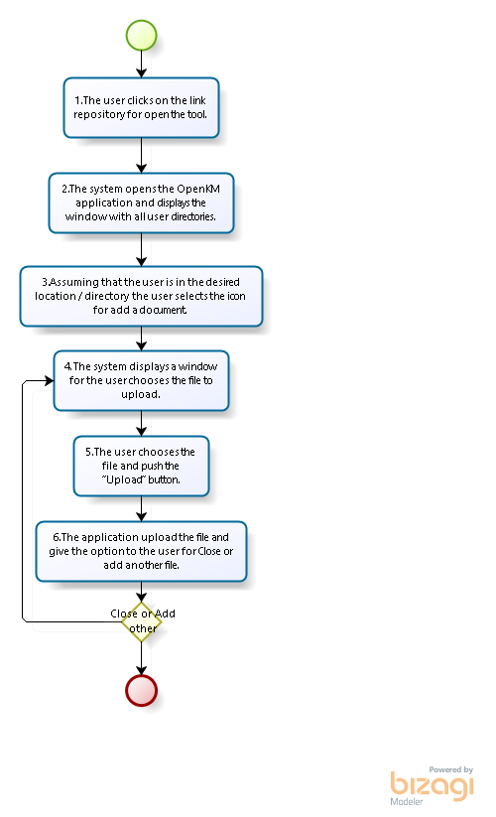
Sample Use case
Add document to repository
Goal: The aim is to allow all users of the application use a document repository where they can access and store all documents that have important character within the field of the application
User | System
1. The user clicks on the link repository for open the tool. | 2. The system opens the OpenKM application and displays the window with all user directories.
3. Assuming that the user is in the desired location / directory the user selects the icon for add a document. | 4. The system displays a window for the user chooses the file to upload.
5. The user chooses the file and push the “Upload” button. | 6. The application upload the file and give the option to the user for Close or add another file.
7. The user push “Close” button for see the file in the repository. | -

Slide 23
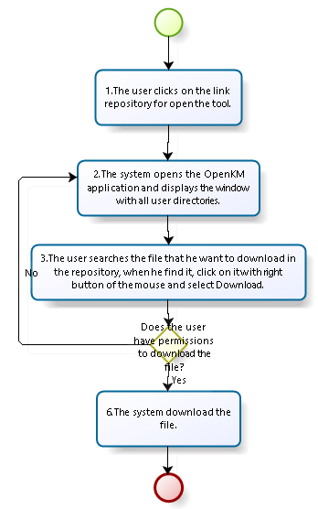
Sample Use case
Download a document
Goal: In this case, we are going to expose the function for download documents or files.
User | System
1. The user clicks on the link repository for open the tool. | 2. The system opens the OpenKM application and displays the window with all user directories.
3. The user searches the file that he want to download in the repository, when he find it, click on it with right button of the mouse and select Download. | 4. The system download the file in your system if he has permission to obtain that document.

Slide 24
Questions?
Thank you for your attention

