Slide 1
Italian consultation
O2-A2 Online course and consultation
with VET teachers and trainers in Italy Aica first draft results till 01/06/16 of the consultation in progress
Pierfranco Ravotto & Francesca Alfano
p.ravotto@aicanet.it francesca.alfano@icanet.it

Slide 2
Multiplier events
Nr | Title | Date | Aim | Participants
E1 | QA Systems in VET" dissemination in Italy (AICA) | May 2015 | Disseminationconsultation | 20
E2 | Contact training with VET teachers in Italy - O2 (AICA) | May 2015 | Start consultation | 12+20 (12+10)
E3 | Contact training with VET teachers in Italy - O2 (AICA) | Dec. 2015 | End consultation | 16
E4 | Contact training with VET teachers in Hungary - O2 (ITS) | May 2015 | Start consultation | 15
E5 | Contact training with VET teachers in Hungary - O2 (ITS) | Dec. 2015 | End consultation | 15
E6 | Consultation with VET stakeholders in Spain - O3 (UAH) | Nov. 2015 | Design | 12+20 (12+10)
E7 | Consultation with VET stakeholders in UK - O4 (CAPDM) | July. 2016 | Prototype | 12+10 (12+20)
E8 | Consultation with VET stakeholders in IE - O5 (ICS) | March 2017 | IQAM | 12+20 (12+1)
E9 | Consultation with VET providers in HU - O5 (TREBAG) | March 2017 | TREBAG | 25
E10 | Project Closing conference in Hungary (ITS) | August 2017 | iTStudy | 50+30 (50+15(
Sept. 15
Done
Sept. 15
Done
To be done

Slide 3
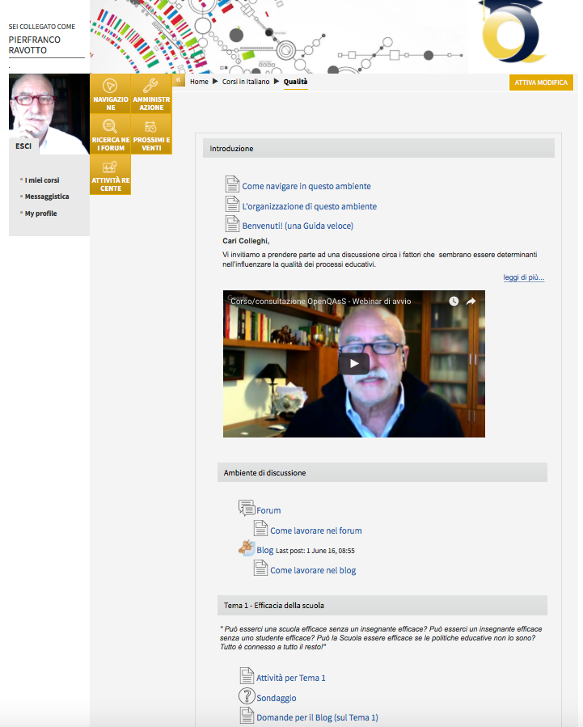
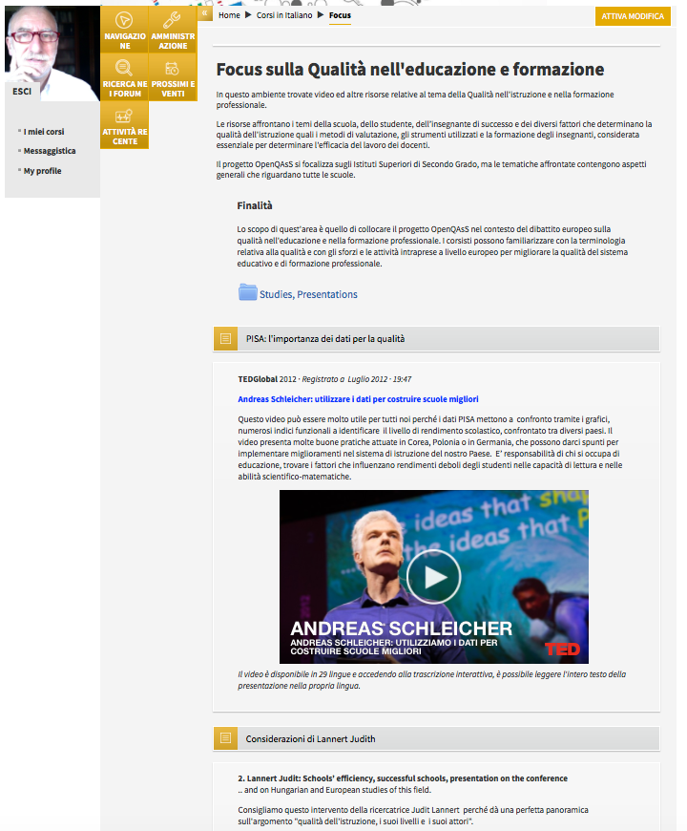
The moodle environment
Discussion on quality
Focus on quality

Slide 4
Focus on quality

Slide 5
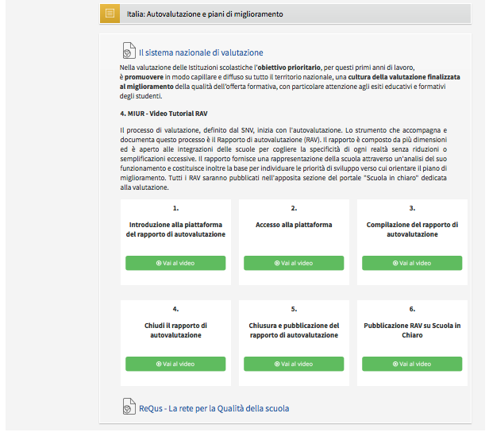
Focus on quality

Slide 6
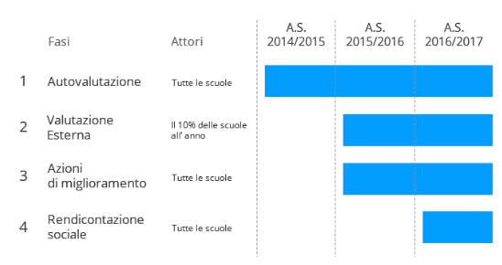
The Italian Evaluation System
Self-evaluation
External
evaluation
Improvement
actions
Social reporting
Compulsory

Slide 7
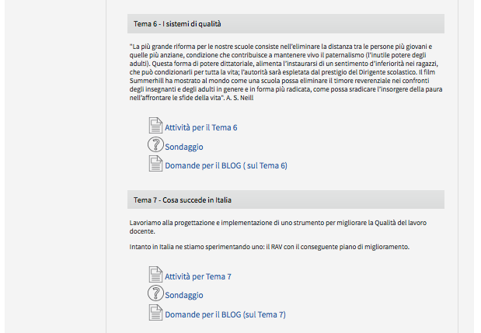
Discussion on quality

Slide 8
7 topics
1st topic - Efficient school, teacher and student
2nd topic - Teaching methods and lesson organisation
3rd topic - Self-reflection - observation and feedback
4th topic - Teacher's collaboration - teacher training, further education
5th topic -Teacher's behaviour
6th topic –QA System and EQAVET – in progress
7th topic –Italian QA System implementation and improvements- in progress

Slide 9
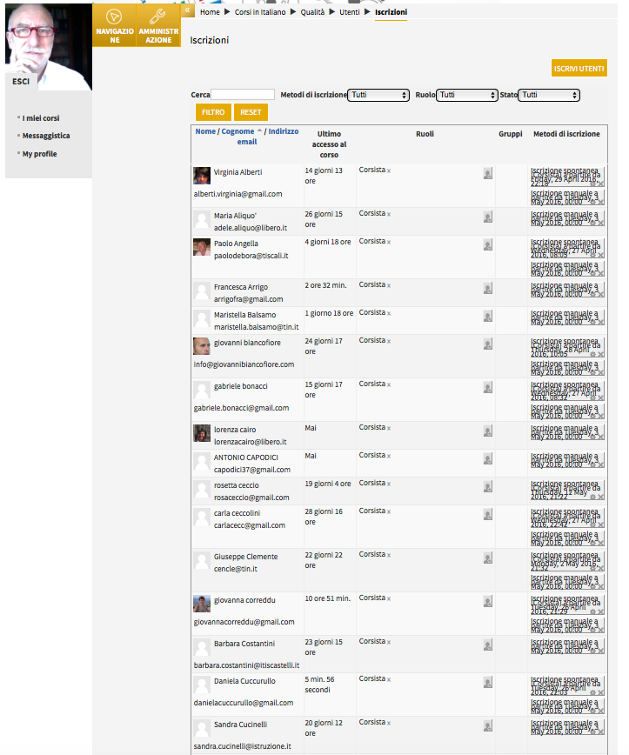
The participants

Slide 10
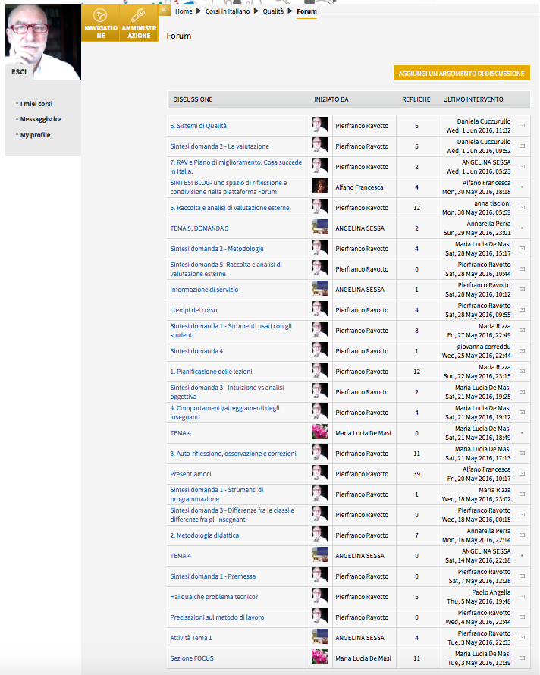
The Forum

Slide 11
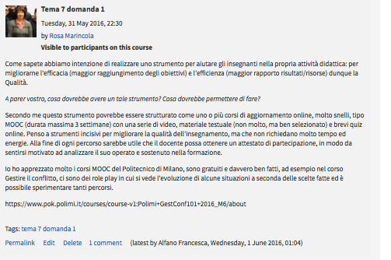
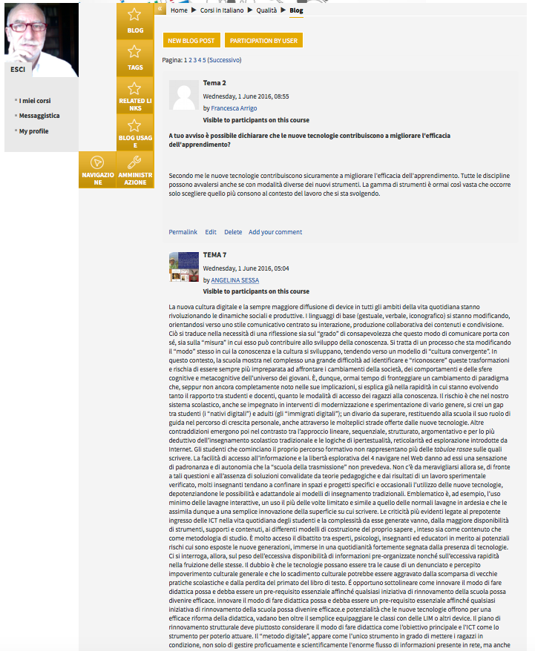
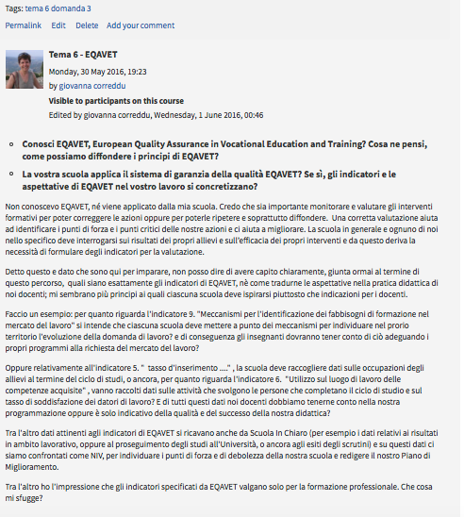
The Blog

Slide 12
Data on partecipation*
Number of Italian participant registered on the platform = 43
Number of participants active on the consultation = 13
Number of Forum = ?
Number of Forum visits = 1.651
Number of Blog posts = ?
Number of Blog visits = 634
*Calculated till 01/06/2016 http://oqacourse.itstudy.hu/report/outline/index.php?id=6

Slide 13
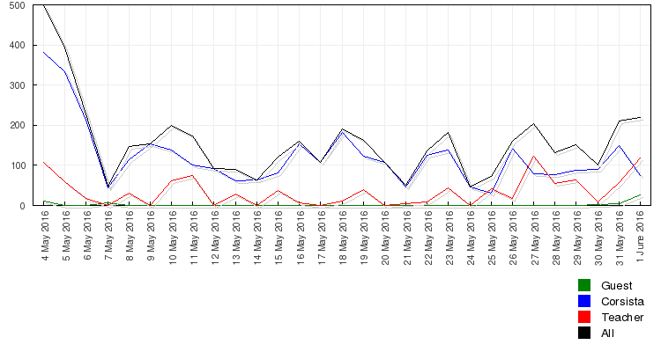
Graphs on participants activities

Slide 14
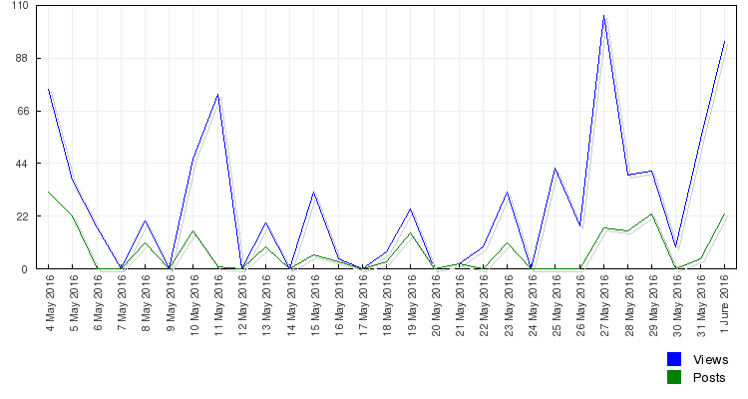
Graphs on views and posts

Slide 15
Voting draft synthesis
Voting- 1st topic - Efficient school, teacher and student
14- We consider a school efficient, where the teaching staffs wants to know the students in a greater proportion, and they want to promote the student's intellectual, mental and physical development compared to their capabilities. 3- The better performance of the students and their more successful progress in the system are important aspects. 7-None of above is accurate enough. 1-I do not think there is really a good definition.

Slide 16
Voting draft synthesis
2nd topic - Teaching methods and lesson organisation
12- ICT is an excellent tool for the development of creativity, but the result is explicitly dependent on teachers.

Slide 17
Voting draft synthesis
3rd topic - Self-reflection - observation and feedback 2- It works intuitively by me, I don't make any documentation. 1- Schoolmaster never provides feedback 1- In addition to the daily load, we don't document regular feedback.1- Online questionnaires are not applicable in our school. 7-Online interface with automated assessment would help a lot for us.

Slide 18
Voting draft synthesis
4th topic - Teacher's collaboration - teacher training, further education 3- We have good cooperation of teachers, it has clearly a good impact on quality and effectiveness. 4-Culture of collaboration of colleagues should be refined because it would help to increase the efficiency. 1-The school management supports the individual development of the teachers and consider it as important. 3-The school management should emphasize the continuous training and development of teachers.

Slide 19
Voting draft synthesis
5th topic -Teacher's behaviour 1-The teacher is also a people, so he/she has right to be offended. 4-The teacher's behavior may determine the fate of the child for a lifetime. 1-You are forbidden to speak about another colleague in front of students. 3-The school staffs atmosphere could specify how the teacher acts. 1-Do not work as teacher, if you cannot love absolutely all the children.

Slide 20
Voting draft synthesis
6th topic – Collecting and evaluating feedbacks & EQAVET- in progress 1-I know the fundaments of quality management. 5-It takes a lot of time to use it intensive. 4-I see advantages in a good constructed quality management software.

Slide 21
Voting draft synthesis
7th topic – Italian QA System implementation and improvents- in progress

Slide 22
Forum draft synthesis
They discussed on many themes:
Use of digital in teaching (Google drive, Dropbox, Moodle, Edmodo, Fidelia, Padlet, Thinglink, Facebook, Whatsapp, Twitter, ...)
Methodology (traditional, group work, guided search
Assessmen
Differences from a class to another, from a teacher to another
...

Slide 23
Forum draft synthesis
... very little till now about quality procedures and quality tools
Just a discussion in which someone highlighted the "instinctive intuition" of the teacher (based on her/his experience) and someone else who stressed on the importance of measurement tools

Slide 24
Blog draft synthesis
Teachers needs:
Teacher preparation and continuos training is a must:
Need of one or more online training courses, very simple, like MOOC ( maximum 3 weeks) with a series of videos , textual material (not many, but well- selected ) and short online quiz. At the end of each course it would be useful if the teacher can get a certificate of participation, in order to feel motivated to analyze his work and sustained in training.
The course should be free of charge

Slide 25
Blog draft synthesis
Teachers needs:
Lack of dialogue, multidisciplinary and interdisciplinary between teachers
Need of online tools to share best practices (temples, procedures, tools to check, evaluate and suggestions to improve PDCA cycle on a regulary basys)

Slide 26
Blog draft synthesis
Teachers needs:
QA system used
The RAV (Italian QA System) is at early stage.
Most of the teachers work with his/her own way of monitoring QA process and results.
QA System should be implemented as a “school-system”, boosted from headmasters and shared as a practice between teachers, otherwise it is not useful for the student class.

Slide 27
Blog draft synthesis
Teachers needs:
EQAVET understanding
Discussion in progress in the platform
Most of the teachers do not understand the indicators n° 5, 6 and 9. What is teacher’s specific role regarding this points?
Difficult for them to get in touch with the world of work and elaborate curricula with employer engagement to prepare students for life.

Slide 28
Blog draft synthesis
Teachers needs:
EQAVET and QA System useful toolkit
Interesting discussion in progress in the platform in this days.

Slide 29
Thank you for your attention
Pierfranco Ravotto & Francesca Alfano
p.ravotto@aicanet.it francesca.alfano@icanet.it

