Slide 1
Quality Assurance in the Hungarian VET schools
Open Source Quality Assurance System for Vocational Education 2014-1-HU01-KA202-002356

Slide 2
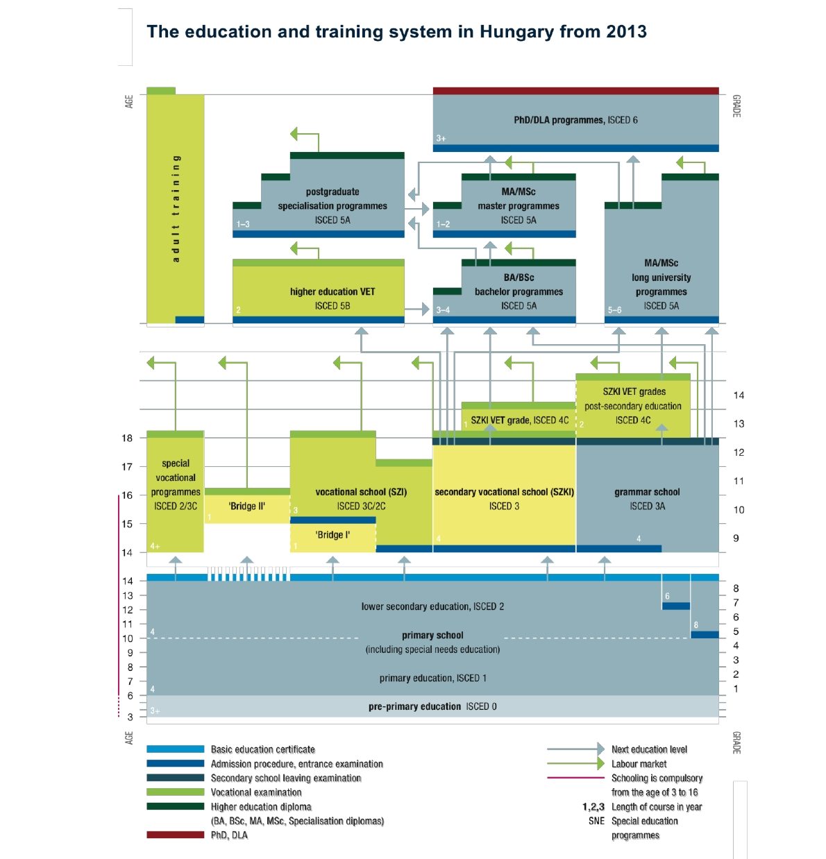
GENERAL INTRODUCTION ABOUT EDUCATION SYSTEM
Adult training
VET

Slide 3
VOCATIONAL AND SECONDARY VOCATIONAL SCHOOL
The graph below shows the breakdown of the full-time students at 9th grade and its changes between 1990 and 2013.

Slide 4
VOCATIONAL AND SECONDARY VOCATIONAL + GRAMMAR SCHOOL (Number of students)
The table below shows that the last school year has not changed the results
yet and significant shift towards high number of students in 9th grade has not
occurred either:
2013/2014 school year (full-time)
Type of school |  | Number of students | % of total upper secondary
Vocational school (SZI) | General education grades (9-10) | 14 026 | 3,12%
 | VET grades (11, 11-12, 11-13) | 99 440 | 22,13%
 | Total | 113 466 | 25,25%
Secondary vocational school (SZKI) | General education grades (9-12) | 150 419 | 33,48%
 | VET grades (13-14/15) | 53 096 | -
 | Total | 203 515 | -
Grammar school | General education (grades 9-12/13) | 185 440 | 41,27%
Total upper secondary level |  | 449 325 | 100,00%

Slide 5
ADULT EDUCATION AND ADULT TRAINING
In the past years the Government introduced several provisions to
enhance participation in adult training.
Despite these efforts Hungary is lagging behind the EU average.
Involvement in lifelong learning is at very low level.
It was steadily decreasing between 2005 and 2013 and slowly
increasing in the past two years.

Slide 6
QUALITY MANAGEMENT IN SCHOOLS
In Hungary quality and quality improvement of
education and training have been in the focus for years.
Series of pilot projects were introduced on the
initiative of the Education / VET Government in power
resulting in a number of innovative tools to support and
promote institutional level quality assurance in VET.
The practical initiatives, innovative tools developed and
implemented within the Hungarian VET sector to
support quality improvement and self-assessment include:

Slide 7
QUALITY MANAGEMENT IN SCHOOLS
2000 – 2004: The COMENIUS 2000 Quality Improvement Programme for Public Education
2002: The Hungarian Public Education Quality Award (PEQA) was established in 2002 by the Minister of Education
2003-2009: Quality Improvement in the Development Program for Vocational Training Schools (Phase I: 2003-2006, Phase II: 2006-2009)
2009-2011: Developing and piloting of an integrated approach to quality management in the Hungarian VET sector as a whole (comprising school-based VET, CVET, adult VET and higher level VET) in line with EQAVET.

Slide 8
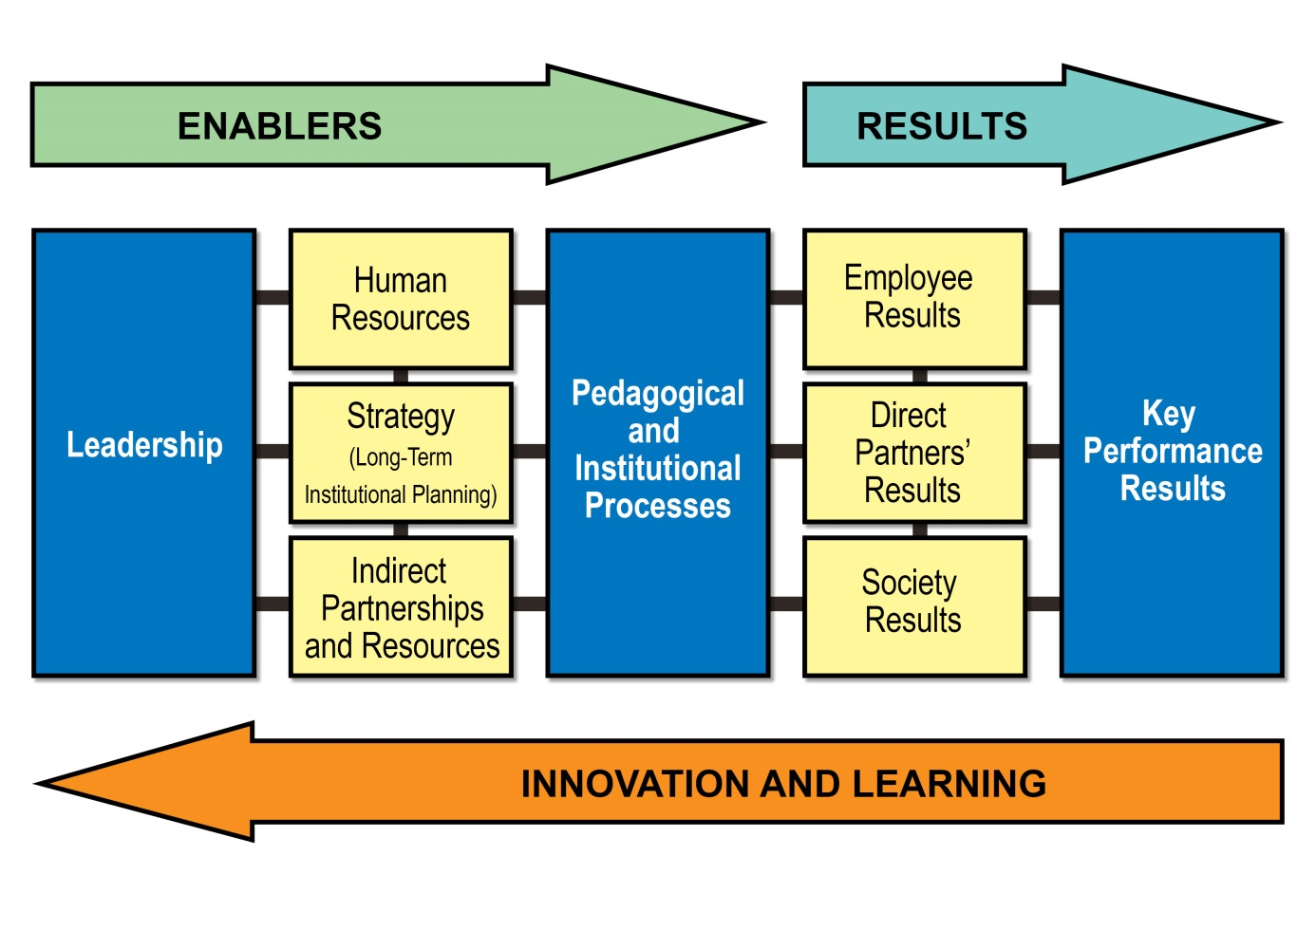
QUALITY MANAGEMENT IN SCHOOLS

Slide 9
QUALITY MANAGEMENT IN SCHOOLS 2013-2015
The present situation of quality assurance in the
operation of Hungarian schools:
School-based and adult education is regulated
separately in Hungary.
Accordingly, the regulation of quality assurance is
different too, although in content they have similarities.
The tables in the National Report present the similarities
and differences of the two types of education.

Slide 10
QUALITY MANAGEMENT IN SCHOOLS 2013-2015
Having a look at the charts, summarizing measuring/assessing activities, it can be seen that the most important criteria of self-assessment can be found in public education, even if they are not applied within the confines of quality assurance.
The system of school inspection (pedagogic-professional controlling model) was introduced in school-based education in Hungary in 2013 – like in most EU countries. It is mainly based on external evaluation, but self-assessment is also part of it.

Slide 11
QUALITY MANAGEMENT IN SCHOOLS 2013-2015
Most important features of self-assessment in connection with
school inspection:
Principle: close relationship of external evaluation (school inspection) and self-assessment
Self-assessment of school focuses on the process of learning-teaching and on the quality of techers’ work
The critera and the tools of the self-assessment of the school/manager/teacher comply with the criteria and the tools of evaluation of the school inspection/manager/teacher; in case of teachers also with the requirements of the system of qualification.
The criteria of school inspection are completed with the criteria and expectations of self-assessment at all three levels.

Slide 12
QUALITY MANAGEMENT IN SCHOOLS 2013-2015
A system for external evaluation can and should be
created and operated in order to achieve the following
goals:
To protect the rights and interest of (adult) students
To make it possible for the schools to provide (adult) students with quality training-education
To support schools in order to be able to continuously develop their operation, professional work and efficiency
To certify self-assessment locally
To collect and analyze data regularly in order to establish local, regional and national planning and development

Slide 13
Thank you for your attention! ☺
Dr. Sediviné Balassa Ildikó Tóth Ildikó

