Slide 1
ICT Tools for supporting QAs
VET Schools
Alcala, 19-20 May 2015
maria.hartyanyi@itstudy.hu

Slide 2
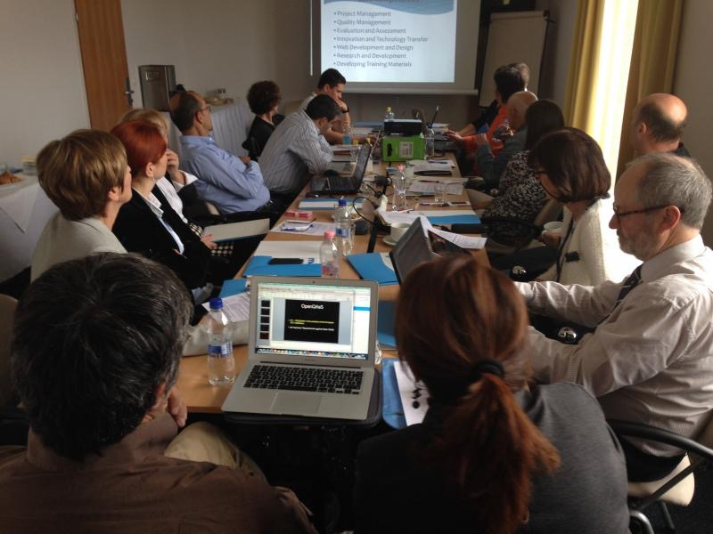
1.
2.
3.

Slide 5
(1) Web-based System for VET Inspection
Social Development Operative Programme 2.2.1-12/1“Improving the quality and content of VET and adult training provision”, subproject 4: Developing a professional process control system in VET.
(2) @Diary Administration System
Digital version of the traditional classroom diary, manages databases used by the schools (students, teachers, groups, subjects, classrooms, etc.). Main modules: Registers for the resources (institutional data, rooms, curricula, equipment, practicing places, etc.), e-Diary Management (timetables, substitutions, etc.), queries, searching, filtering figures of the e-Diary (classroom lessons, records of absences, reports, etc.).

Slide 6
Increasing the focus on quality assurance
to simplify, explain and communicate existing instruments rather than increase the number of indicators;
to strengthen the quality assurance culture by convincing, motivating and training teachers, trainers and managers;
to relate quality assurance tools to the assessment process, based on learning outcomes;
to put the focus of the quality cycle on responding to the needs of learners and on the needs of employers
Public consultation for the European Area of Skills and Qualifications launched by the European Commission, 2014

Slide 7
Suggestions of the headmasters (SZÁMALK and Handler)
Managing quality goals related indicators
Survey module: standardized handling of tools for measuring the satisfactions of the partners (students, parents, maintainer, chambers, labour –market)
Process controlling system, with indicators mapped in the processes
Supporting the self assessment of teachers and headmasters
Supporting inside communication
Supporting knowledge sharing and knowledge management
Climate tests for measuring the impact of the system
Document repository

Slide 8
Your ideas?

Slide 9
PLAN
DO
Communication
Act
Check
PDCA
Quality Assurance Manual
Documentation
Self
Assessment

