Slide 2
ICS Group Overview

Slide 3
ICS Skills Objectives
To improve Digital Literacy
To promote Technology Education
To drive use of Technology in Education
To support the profession

Slide 4
ICS Skills Statistics
41 F.T.E.
Established 17 years (47 years for ICS)
About 900 accredited testcentres
6,000+ testers (proctors)
4,000+ professional members
Increase in turnover and trading profit each of last 8 years
Turnover 2013 - €4.2 million (approx)
Investing €1.5 to €2m in initiatives

Slide 5
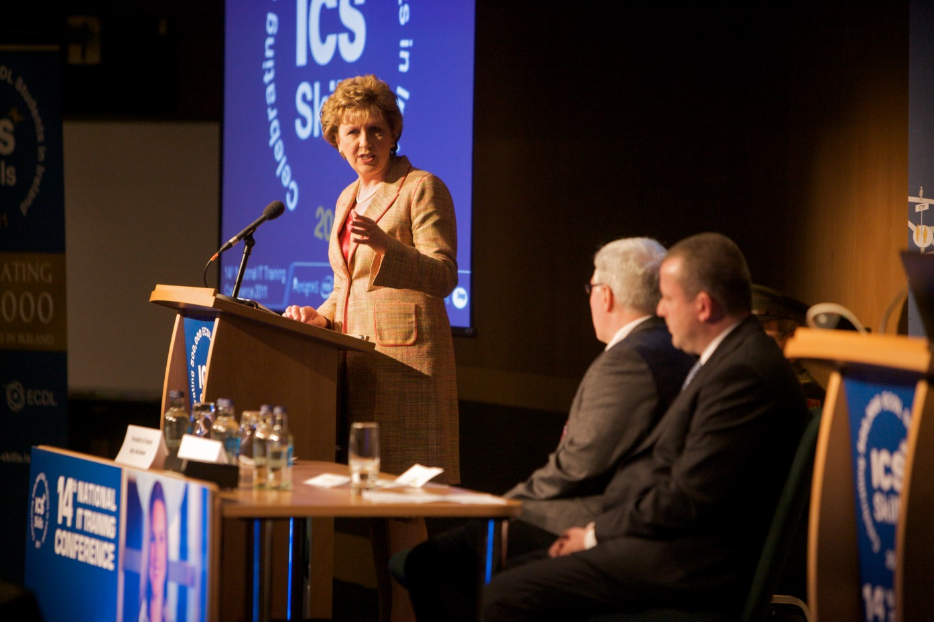
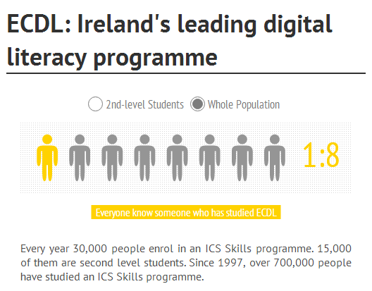
Proven Success

Slide 6
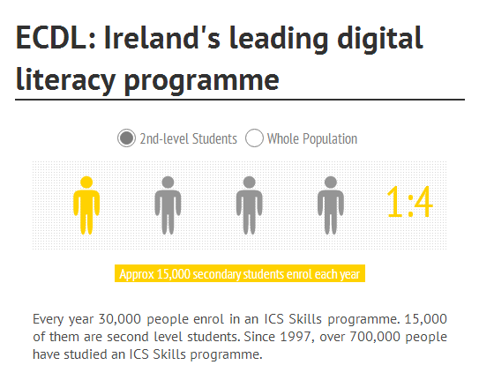
Our accredited centres
50% of second-level schools offer ECDL

Slide 7
ICS Skills In Education
Excellent track record in Post-Primary
ECDL
F1 in Schools
Scratch
ChooseIT
JC Computing Curriculum
ICS Grid
Growing engagement with Primary schools
Scratch
Benefit IV funding - €250,000
Digital Literacy – CLISTE
Brand new approach for primary schools
Digital Citizenship

Slide 8
ICS Skills Market

Slide 9
Our current solution
API
API
Automated Test System
CRM/Case Mgt
Contracts Mgt
API
API
API/EXPORT
API/EXPORT
API
API
API
API
LMS
ics-skills.net
Accounting System
API
API
DATA EXPORT
ICS Skills Centre and Candidate Administration System
Online Shop
Login
Login
Login
Business Intelligence System*
BACK
OFFICE
Back Office Portal
Test Centre Portal
Student Portal

Slide 10
Vocational Education and Training
Non-segregated second level education system
Traditional secondary schools
Largely academic
Objective to send students to university
Community School
Former technical colleges
Off full academic and practical curriculum
Many students do apprenticeships, get other vocational qualifications

Slide 11
Further Education and Training
Post second-level colleges
“second chance” education
Teenagers
Adult education
Vocational qualifications
Bridge to third level education for some
SOLAS significant in the sector
Irish government training authority
Training the unemployed
Upskilling the workforce (non-professional)
Quality Assurance by FETAC (QQI) – national awarding body

