Slide 1
O1
QA System in the practice the European VET institutions
RESPONSIBLE PARTNER: P6-CNR

Slide 2
Aim
The consortium will carry out comprehensive desktop research in order to map out the state- of-the-art with respect to the implementation of EQAVET and of running quality assurance systems in European VET institutions.
The aim of this work phase is twofold:
  to create a solid basis for the development of Open QAsS Toolkit via a detailed requirement analysis;
  to produce a valuable study for use by all actors in vocational education, systematically revealing both the problems and good practice.

Slide 3
The activities
O1-A1 Set up a research plan: define the tools and methods (P6- CNR)
O1-A2 National reports - review the current level of implementation of EQAVET Reference National reports - review the current level of implementation of EQAVET Reference Framework (and the related tools: EQF, ECVET) in each of the partner countries (P5 SZÁMALK)
O1-A3 Identify best practices of QAs in the European VET providers (IVET/ CVET) (P4 CAPDM)
O1-A4 Review existing ICT supported QA Solutions. (P2 UNIVERSIDAD DE ALCALA)
O1-E1 – 1° Multiplier event (P3-AICA)

Slide 4
Target group and beneficiaries
Target group: OpenQAsS system designer, headmasters, teachers/trainers of VET providers
Final beneficiaries: the students !!!!!

Slide 5
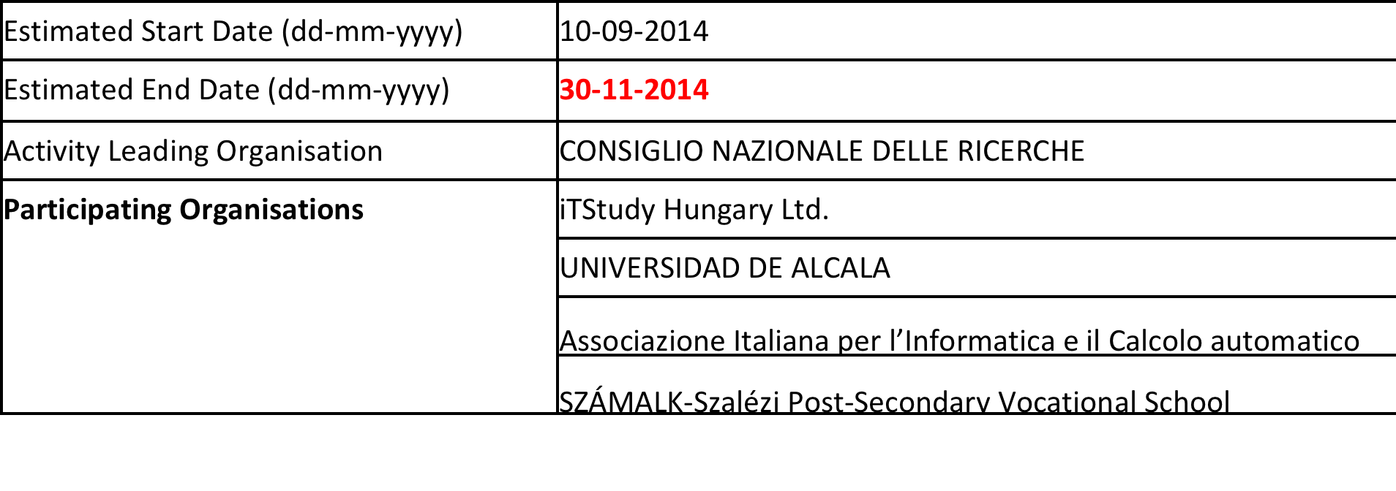
o1-A1 Setting up a research plan, define the tools and methods
The research will be performed by the partners working in different areas in vocational education, so there is a strong need for agreement on the main goals to fully define the challenges we are seeking to address.

Slide 6
o1-A1 Setting up a research plan, define the tools and methods
The partners have to:
  Agree on the specific research questions (hypothesises) to be answered; [goals of the project?]
  select the methodology to be used;
  enumerate the type of resources they will employ;
  define standards for reporting.
  (Risk management?)

Slide 7
O1-A1 the rationale
The critical points hindering the effectiveness of EQAVET has been identified in various earlier, relevant studies and reports (e.g. EASQ consultation papers, March 2014).
These studies offer supporting reasons, and strongly suggest the need for ICT based solutions to support institutional quality assurance systems, but also that a systematic research plan is needed to guarantee that any work will lead to the development of a consistence package that answers questions such as
  how can institutional quality assurance systems contribute to the development of transversal skills within students;
  how can it help to decrease the skills gap between education and work;
  how can the potential of 21st century ICT and networks be utilized in order to significantly improve the present situation.

Slide 8
O1 – A1 let’s understand each other !
Which form of VET in our project:
  adult learning
  school-based VET
  higher VET
  non-formal and informal learning
  digital learning
  MOOCS
Cultural and educational path differences:
  Vocational vs further ET
  We do not have colleges in Italy

Slide 9
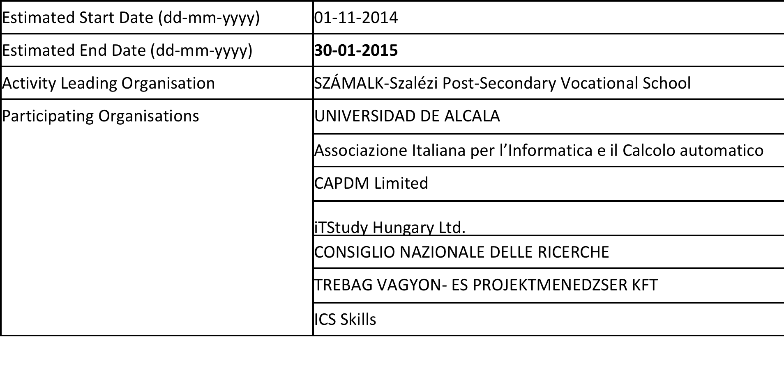
O1-A2 National reports
review the current level of implementation of EQAVET Reference Framework (and the related tools: EQF, ECVET) in each of the partner countries

Slide 10
O1-A2 National reports
review the current level of implementation of EQAVET Reference Framework (and the related tools: EQF, ECVET) in each of the partner countries
The aim of this activity is to analyse and compare the present state and practice of quality assurance systems (rules and methods of accountability, school inspection, control and monitoring, etc.) in VET systems of the partner countries.
Preliminary investigation shows significant differences in both the implementation of EQAVET and in the practice of institutional quality assurance methods among the participant countries.

Slide 11
o1-A2 National reports
The outcomes of this activity will be national reports in English to provide figures for the final O1 including a comparative analysis of the five partner countries (HU, UK, IE, IT, SP).
Throughout this working phase we focus on practical methods within the different QAsS with the aim of identifying common elements for standardization in an ICT model.
These national reports will be elaborated by using the research plan, methods and standards determined in 01 - A1.

Slide 12
o1-A2 National reports
All partners will take part in elaborating the national reports; in Italy the responsible partner will be P3 AICA, in Hungary P5 SZÁMALK.

Slide 13
O1 – A2 Ideas for implementation
Starting point (documents? Reports? Commission documents? National documents?). Example: EQAVET: Towards a European area of skills and qualifications
What do we mean by ‘practical methods’?
Are ‘practical methods’ immediately transferable from a Ntl system to another?
Should we focus on a specific VET form?
Can cultural factors to hinder transferability (between secors and countries)?
How to report results
….
Who is responsible for the comparative analysis?

Slide 14
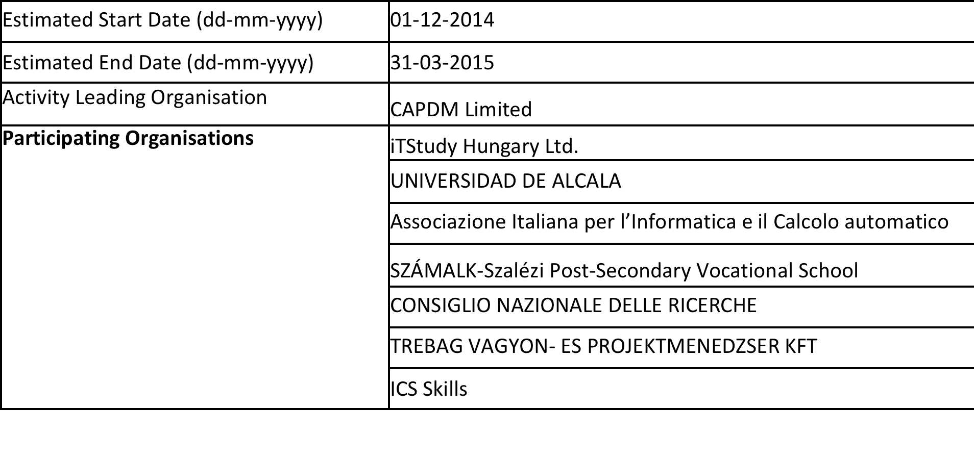
O1-A3 Identifying best practices of QAs in the European VET providers (IVET/CVET)
to identify the best solutions in QAS (school inspection, in "peer review" QA methods, self-evaluation, control and monitoring systems, tools and rules of external evaluation.)

Slide 15
O1-A3 Identifying best practices of QAs in the European VET providers (IVET/CVET)
to identify the best solutions in QAS (school inspection, in "peer review" QA methods, self-evaluation, control and monitoring systems, tools and rules of external evaluation.)
The overall aim of O1 related activities is not to find and create new QA instruments for VET, but to reveal existing ones that have been used successfully within various countries.
We intend to assemble the most effective VET-specific methods such as:
  Strengthening the quality culture of the institutional staff;
  Integrating the demands of the labour market;
  Supporting new pedagogical methods for developing 21stcentury skills of the students;
  Assuring assessment processes based on learning outcomes.

Slide 16
O1-A3 Identifying best practices of QAs in the European VET providers (IVET/CVET)
Best practices in all partners’ countries.
At least three countries will be added in the review - Netherland, Denmark, Finland which have long traditions and effective results in EQAVET implementation.
Two partner countries (Scotland and Ireland) also have established and proven systems, hence they will represent the starting point, and be the knowledge exporters of this activity.

Slide 17
O1-A3 Identifying best practices of QAs in the European VET providers (IVET/CVET)
All partners will take part in elaborating the national reports; in Italy the responsible partner will be P3 AICA, in Hungary P5 SZÁMALK.

Slide 18
O1 – A3 Ideas for implementation
Definition of best practices / good practices
Factors to be investigated, how do we measure them and which are the thresholds? (what does transform a practice into a good/best practice?)
How to select projects / initiatives / cases
How many?
Definition of a grid to guide analysis and identify best practices
How to report results
….
Who is responsible for Netherland, Denmark, Finland

Slide 19
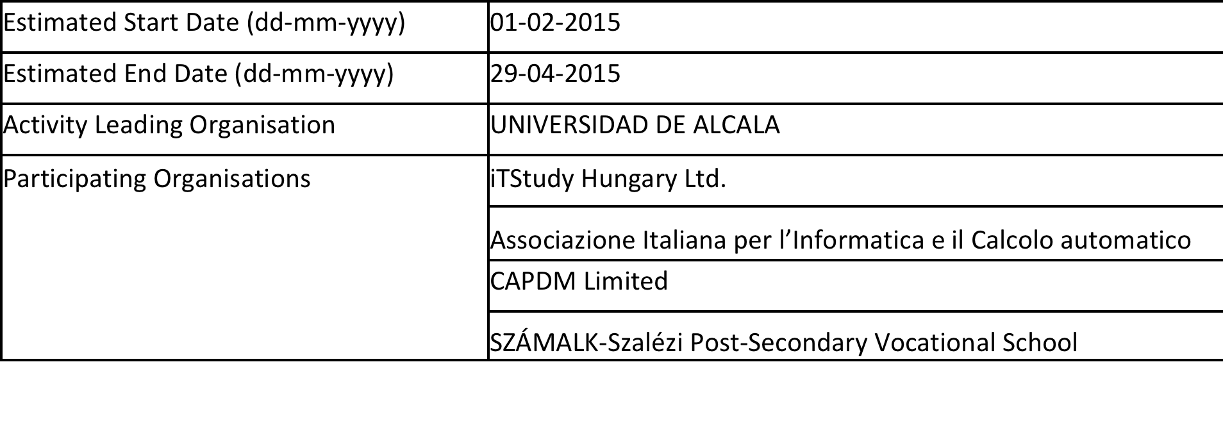
O1-A4 Review of the existing ICT supported QA Solutions
Market research on ICT tools that support QA solutions

Slide 20
O1-A4 Review of the existing ICT supported QA Solutions
One of the main outcomes of the project will be an extensible, flexible open source software toolkit, with an initial focus on existing IT Solutions used for supporting institutional QA systems.
During the preliminary needs-analysis partners have been asked to provide figures on existing Solutions and approaches in their countries.
The result of this review shows that there are several offline and Web-based IT applications in partner countries, but that there is virtually no complete solution offered for QAS in VET particularly for the educational sector.
Some examples of using IT tools for advanced QA processes have been identified, but these cover only some parts of the activities required of an institutional QA system.

Slide 21
O1-A4 Review of the existing ICT supported QA Solutions
All the partners with IT profile: Pl ITStudy, P3 AICA, P4 CAPDM, P5 SZÁMALK

Slide 22
O1 – A4 Ideas for implementation
Definition of the dimensions of QAS (e.g. rules and methods of accountability, school inspection, control and monitoring, etc.)
Classification of ICT tools according to the dimensions
Should we evaluate the of the ICT tools? (efficiancy; usability; openess; …)
How many?
Definition of a grid to guide analysis of ICT tools (or are dimensions enough?)
How to report results
….

Slide 23
Acceptance by a community will rest on a system plan for Open QAsS that incorporates best practice from existing tools and methods, even if these cover only parts of the final toolkit, and alignment with real user needs.

Slide 24
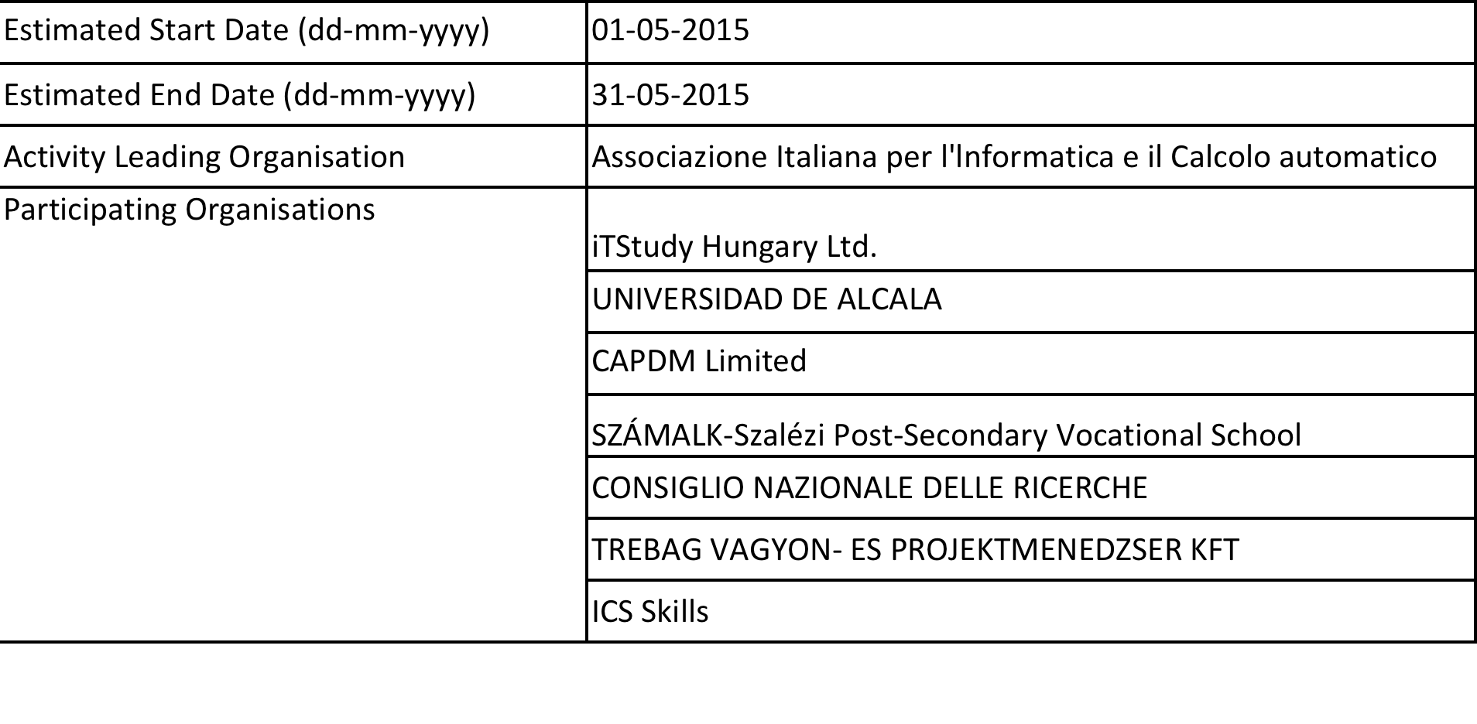
E1: "QA Systems in VET" dissemination in Italy
P3 AICA will be the organiser; P6 CNR will collaborate in planning the programme. All partners take part on and evaluate the event as the 2nd partner meeting will be related to this event.
Number of participants: 20 (IT) + 12 foreigner

Slide 25
Next steps: WWW
The partners responsible for (01)-A2-A3-A4 will send me:
  specific research questions (hypothesises / goals of the project) to be answered
  Background information (preliminary needs-analysis)
  Ideas on the methodology to be used
  the type of resources you will employ
  Specific tasks to complete the activity
  Risk management
Deadline: 2 weeks before the deadline for O1-A1 (next Friday !)

Slide 26
Connections with other Ox
In the final version of 01 all the results of the four activities will be used as resources and guidance for the next steps of the project implementation.
For example in 02 all the content created in 01 will be directly integrated into the keynote materials for the online consultation with VET teachers and trainers.

