Slide 1
OpenQAsS
Quality Management Evaluation Strategy
István Zsíros iTStudy Hungary Ltd.
Budapest – Hungary 6th-7th November 20174

Slide 2
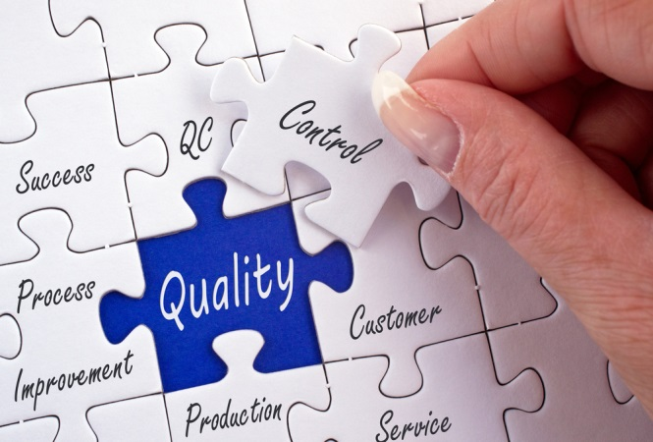
Quality Management
The main aim of the quality management is to evaluate the quality of results and the effectiveness of the products in a continuous process
during the whole life of the project, facilitating criticism and communication among partners (internal evaluation) ensuring that products meet the aims of the project, as expressed in the application form.

Slide 3
Quality Management
Quality management, uses quality assurance and control of processes and products to achieve more consistent quality.
PURSUE OF CONTINUOUS IMPROVEMENT
Control of processes
Identification and analysis of failures
Preventive and corrective actions
Involvement of the whole team

Slide 4
Quality Management System
IMPLEMENTATION OF A QM SYSTEM:
Guidelines:
Internal communication
Delivery of documents / Templates (OpenQAsS_final_report_P1_HU_v2.docx )
Short guidelines for meetings

Slide 5
QpenQAsS – Quality Management System
MONITORING ACTIVITIES:
Ongoing monitoring activities - by all partners
Ongoing financial controlling (financial reports)
Monitoring activities regarding the completion of single outputs: final check and approval of results by the coordinator and the respective output leaders
Each Output leader -always in close contact with project promoter
Each partner should complete quality/evaluation tools design by Quality leader.

Slide 6
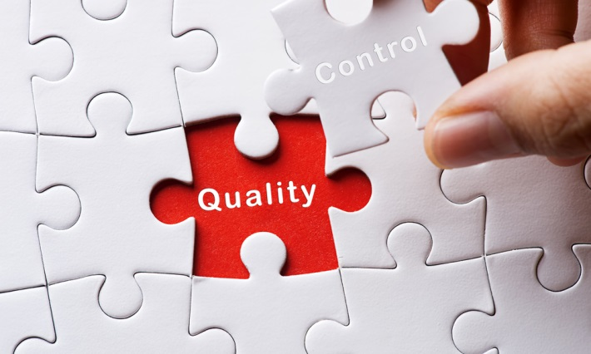
QpenQAsS – Quality Management System
EVALUATION REPORTS:
1) Evaluation of the 6 transnational meetings (HU, IT …)
2) Evaluation report (7 Outcomes)
3) Evaluation report on processes & products at Final Stage

Slide 7
OpenQAsS – Quality Management process
SUMMING UP, THE EVALUATION PROCESS WILL BE COMPOSED OF THE FOLLOWING STEPS:
1.- For each Output: first evaluation by coordinator and the Output leader.
2.- Completion of evaluation questionnaires (designed by iTStudy) at the end of each Output. (suggestions)
3.- Elaboration of an evaluation report (by iTStudy).

Slide 8
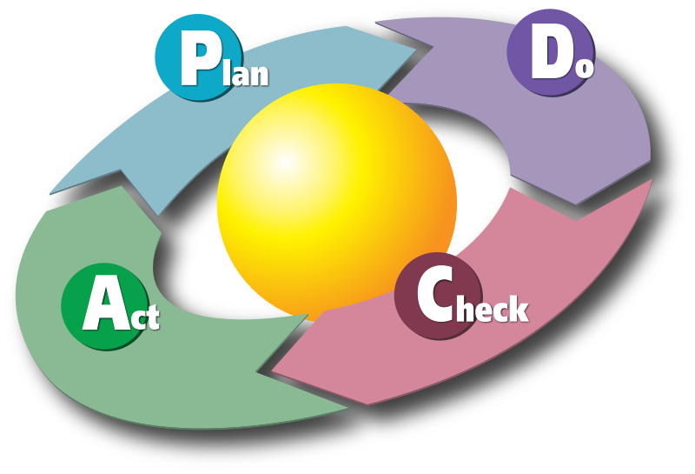
Quality Management - Proposal
One of the most widely used processes for quality assurance Management and continuous improvement is the PDCA approach.
PLAN
DO
CHECK
ACT

Slide 9
Tools for assessment
QUESTIONNAIRES
Rapid and easy to be used.
Can be adapted/ personalised.
It does not requires much time to be completed.
The information can be recorded, as it is written information.
The information may be easily registered, as questions usually are not complex.
Allow for combination of questions:
Yes/no.
Open questions.
Ranking scale.
Multiple choice.
Mixture.

Slide 10
Thank you for your attention!
OpenQAsS Quality Management
Budapest - Hungary 6th-7th November 2014

