Slide 1
OpenQAsS Dissemination Progress
Edinburgh, 2nd June, 2016
Trebag Ltd.

Slide 2
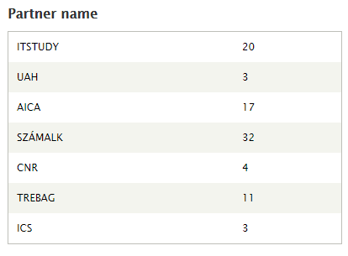
DISSEMINATION up to date
.

Slide 3
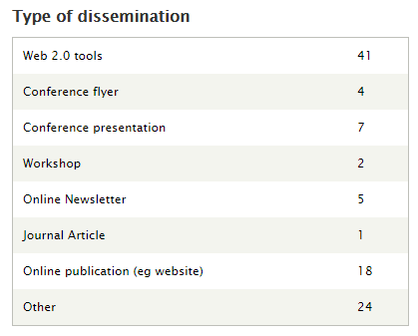
DISSEMINATION up to date
.

Slide 4
Dissemination in the interim
Critisized mainly for not including information and website address on partners
Webpages.
This is basic publication requirement.
Please do it and document it in the form on platform.

Slide 5
Pushing dissemination via Web2.0
As discussed in Milan, the dissemination activities on WEB2. 0 tools is pushed by one assigned partner every 3 months. The responsibles follow in the order of partner numbers. So far P1, and P2 have been "on duty", and from May till the end of July P3- AICA will be in charge.
The task is to monitor partners to upload content about the project and related fields on web 2.0 tools and also that the responsible partner get an intensive activity in this field.
It is expected that at least 5 entries/per month in 3 different tools shall take place (15 entries in 3 various means. Would be nice if the majority is something else than facebook.
At the end of the period a small report is expected about these activities.
.

Slide 6
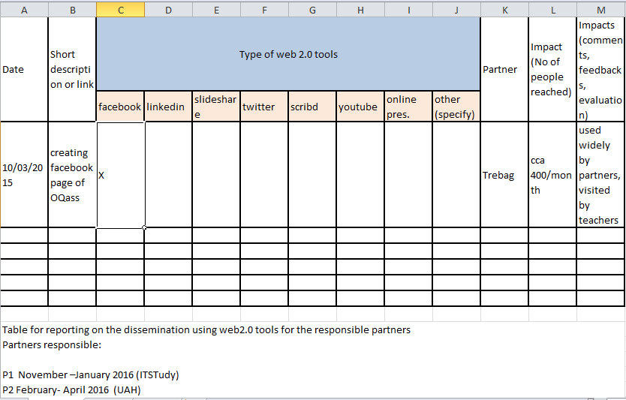
Pushing dissemination via Web2.0

Slide 7
Intellectual outputs – dissemination of them in the newsletters
Outputs | Languages | Medias
O1 Study/Analysis | 4 languages | Publications Text file
O2 Study/Analysis | 4 languages | Network Website Text file Video
O3 Study/Analysis | English | Publications Text file Software
O4 (Toolkit) Other | English | Publications Text file Other
O5 Course/curriculum | 4 languages | Text file Website
O6 Methodology/guidelines | 4 languages | Website Text
O7 Service/structure | English | Website

Slide 8
Thank you for your cooperation! ☺
Eniko Nagy, Trebag Ltd.

