Slide 1
OpenQAsS Quality Manager Loquet project
Edinburgh, 2nd June, 2016
Trebag Ltd.

Slide 2
Loquet-Learning Outcomes in Quality in Education and Training
Project on the quality assurance in VET education
The LOQUET project aims to fill this gap by transferring good practices from the field of quality management in the businesses to the sector of Vocational Education and Training (VET) in seven countries: Poland, Greece, Cyprus, Sweden, France, Hungary and Germany.
Overall it is expected that in the short term, the project will contribute to the capacity building of quality assurance managers in VET institutions while in the long term it will make a contribution to quality assurance systems in the VET sector across Europe

Slide 3
Furthermore the LOQUET project aims:
to develop a competency profile framework for quality managers in VET institutions, so as to be able to design, implement, evaluate and review effective quality management systems in their institutions;
to introduce a comprehensive unit-based training course – expressed in terms of transferrable learning outcomes - for VET quality managers in line with the requirements of the European Quality Assurance Reference Framework Recommendation (EQARF Recommendation);
to raise awareness regarding the importance of the EQAVET principles in VET institutions across Europe.

Slide 4
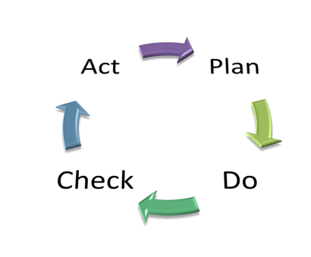
Competence profile of a quality manager
Based on PDCA cycle

Slide 9
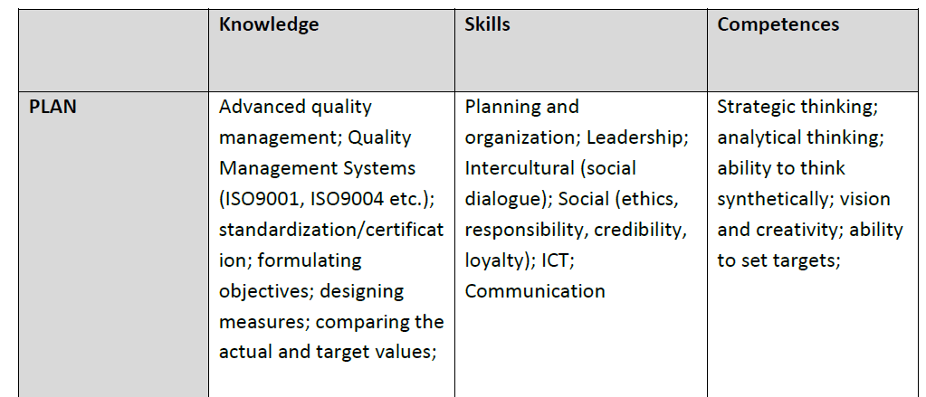

Slide 13
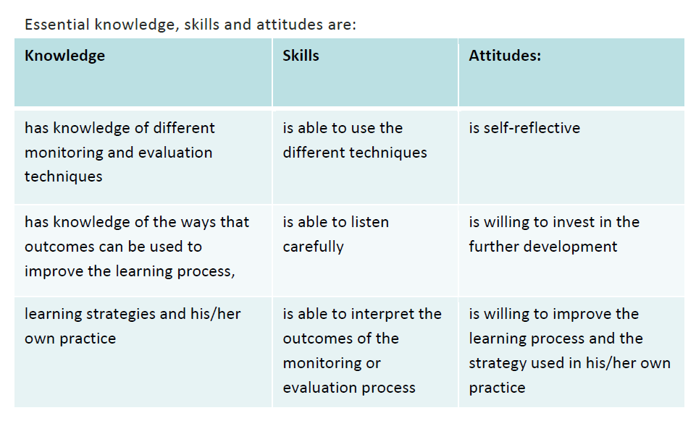

Slide 14
Thank you for your cooperation! ☺
Eniko Nagy, Trebag Ltd.

