Slide 1
OpenQAsS O2 O2 – Teachers’ Requirements against OpenQAsS Project level summary of the survey
Giovanni Fulantelli – Edinburgh 2-3 June 2016

Slide 2
Survey structure
Section 1: Respondents data
Section 2: Working environment
Section 3: IT Infrastructure and IT Skills
Section 4: Quality Assurance Experiences
Section 5: Requirements
Section 6: IQAM course

Slide 3
Survey structure
Section 1: Respondents data
Section 2: Working environment
Section 3: IT Infrastructure and IT Skills
Section 4: Quality Assurance Experiences
Section 5: Requirements
Section 6: IQAM course

Slide 4
Survey structure
Section 1: Respondents data
Section 2: Working environment
Section 3: IT Infrastructure and IT Skills
Section 4: Quality Assurance Experiences
Section 5: Requirements
Section 6: IQAM course

Slide 5
QA system attitude
Section 4: Quality Assurance Experiences
HU: Two-third of respondents are not convinced by the usefulness of a quality assurance system. However a well managed quality assurance system is able to improve the reputation of the school, promotes further professional development of staff and has a positive effect on the quality of teaching/learning.
IE: Respondents are nearly split between suggesting that the benefits of a QA system are worth the effort or implementing and being indifferent to them.
SP: Despite teachers’ reluctance, most of respondents agree with the advantages of a QA system: the main is improvement of the reputation of the school but the rest is also perceived by high percentage of respondents
IT: teachers are reluctant to take part in running Quality Assurance System work (54%): nevertheless, mostly of responders agree that the advantages of using a well managed Quality Assurance System Improves the reputation of the school and its attractiveness for prospective student, .......

Slide 6
QA resistance
Section 4: Quality Assurance Experiences
HU: Teachers’work is hold back by overload, and preparation for too formal and often stressful external audits.
IE: QA systems and implementation are generally viewed as adding to current heavy workloads, and presumably not adding sufficient value to making time for them.
SP: Unfortunately reluctance of teachers exists due to overload (85%), lack of belief in QA (73%) and costs of external assessment (69%).
IT: The following circumstances hold mostly back work on the field of quality assurance: preparation for external assessments, which are often onerous and overly formal (54%).

Slide 7
Methods/tools already used
Section 4: Quality Assurance Experiences
HU: Most commonly used methods from the quality assurance toolkit are the brainstorming and the PDCA-cycle (force field analysis is unknown to almost half of the respondents)
IE: Use of these tools and methods is not common for the majority of respondents.
SP: Most commonly used methods from the quality assurance toolkit are flow charts (67%) and brainstorming (63%) while the PDCA-cycle and force field analysis are rarely used.
IT: The most popular tools and methods regulary used are the brainstorming (24%) and the Flow charts (25%).
Only a small percentage of the responders are using some kind of Quality software (e.g. MS Project)

Slide 8
Section 5: Requirements
Expectations and requirements towards the OpenQaSS toolkit
Giovanni Fulantelli – Edinburgh 2-3 June 2016

Slide 9
Which of these quality approaches is considered most suitable for your school?
Self-assessment of quality: the school assesses processes and indicators to inspire further improvement
Oriented to possible external audits by a third-party
Both
HU
IE
SP
IT

Slide 10
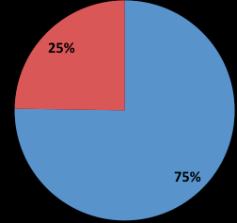
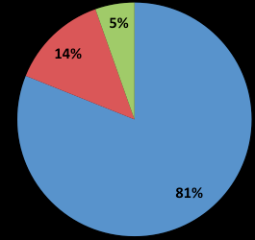
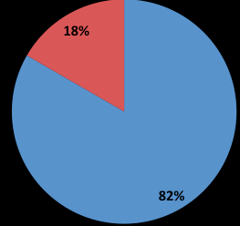
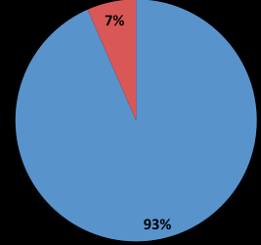
Do you consider it important that the Quality Assurance System supports uploading evidence (documents, reports, etc.) to justify each assessment item?
Yes
No
No answer
HU
IE
SP
IT

Slide 11
Which activities could be supported by a IT-based Quality Assurance System?
activities related to school organization (Timetable, tutoring, managing spaces and resources, internal committees, internal communication, etc.) (HU; IE; IT)
measurement of students satisfaction (HU; IT)
measurement of teachers satisfaction (HU; IT)
Student certification and transfer to further education (IE; IT)
Attainment of learning objectives, exam results, individual student progress relative to their baseline standard (SP)
planning of learning activity (SP)
learning activity (SP)
Measurement of parents satisfaction (IT)

Slide 12
Top 7 activities/processes that are considered to be most important to implement a Quality Assurance process in a school
Planning of learning activities (HU3; IE4; SP1; IT1)
Professional development and motivation of staff (HU6; IE1; SP3; IT2)
Measurement of students satisfaction (HU1; IE6; SP1; IT5)
Attainment of learning objectives, exam results, individual student progress relative to their baseline standard (HU7; IE2; SP3; IT3)
Teachers’ reflection on progress and the effectiveness of their approach (HU4; IE3; SP7; IT7)
Measurement of teachers satisfaction (HU2; SP5; IT6)
The Strategic direction, leadership and planning (IE7; SP7; IT4)
Learning activity (HU5; SP5)
Student certification and transfer to further education (IE4)
Documentation of the quality management system (IE7)
Maintenance of facilities and services (SP7)

Slide 13
Do you use any other IT tool for Quality Assurance System? Please specify which tool If you use any other IT tool for Quality Assurance System, can you specify for which activity?
(IMIP; Google survey; Microsoft Excel; mysurvey.com) - IT tools are mostly used for creating and analysing questionnares and tables (HU)
internal quality tools used on a voluntary basis from teachers in their schools (IT)
(Management Information System - Internal Database) - likely to be focused on administration, health and safety, subject choices and exam results (IE)
No relevant (SP)

Slide 14
What would help you in your Quality Assurance work?
HU: The most useful help are the attaining of appropiate knowledge (guides, experiences, skills); an adequate time-management and the establishment of clear objectives and tasks.
IE: Respondents want time, allocated resources, guidelines and recognition as priority
SP: Doing internal audits; Time to organize and develop activities; An assistant; Motivation of staff
IT: project management tools to review progress and effectiveness of their teaching approach, compared to similar schools, with a team working approach to share models, ideas and practical examples, always oriented to customer (maybe students and parents?) and stakeholders satisfaction.

Slide 15
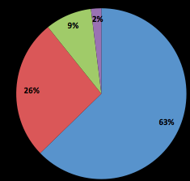
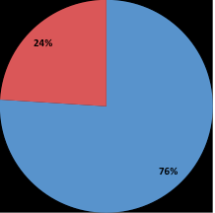
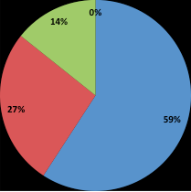
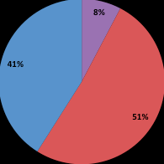
Have you heard of the European quality assurance initiative, called EQAVET?
No, I have not heard about it
Yes, I heard about it, but I do not have detailed information on this system
Yes, I am aware of the EQAVET principles, defining quality criteria and indicators for vocational education
I am fully aware of EQAVET, and implement the quality criteria and indicators it defines.
HU
IE
SP
IT
Giovanni Fulantelli – Edinburgh 2-3 June 2016

Slide 16
Section 6: IQAM course
Giovanni Fulantelli – Edinburgh 2-3 June 2016

Slide 17
Would you be interested in participating in this course at your school or local venue, and obtaining the international IQAM qualification?
 | HU | IE | SP | IT
Yes | 49 | 54 | 59 | 83
No | 51 | 46 | 41 | 17

