Slide 1
Structure of a national curriculum
in VET in Italy
Pierfranco Ravotto & Francesca Alfano
p.ravotto@aicanet.it francesca.alfano@icanet.it

Slide 2
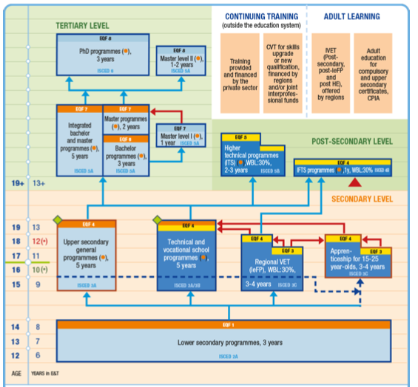
Italian School System

Slide 3
Italian School System
Technical
Institutes

Slide 4
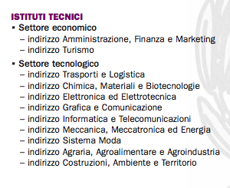
Secondary School: Informatics

Slide 5
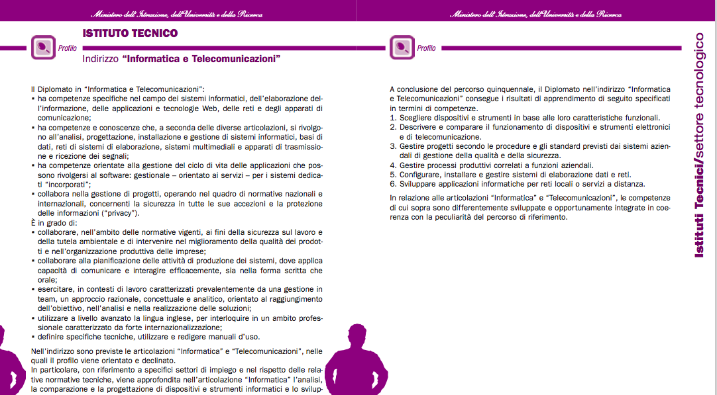
Professional Learning Outcomes

Slide 6
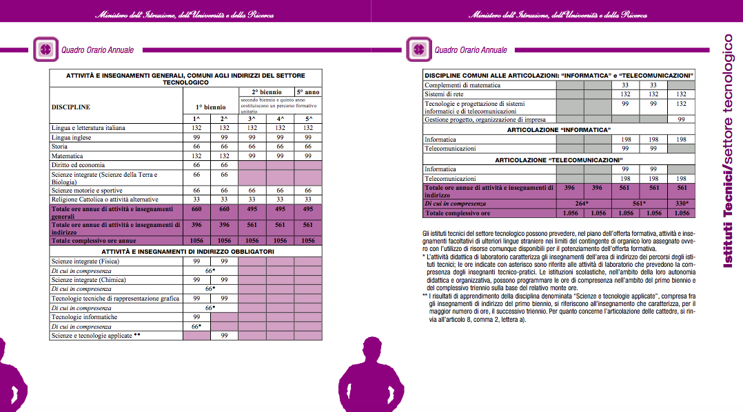
Learning path

Slide 7
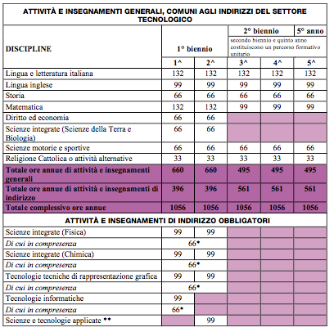
Learning path

Slide 8
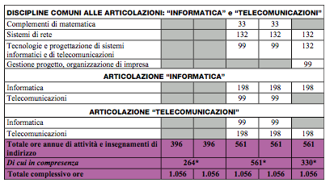
Learning path

Slide 9
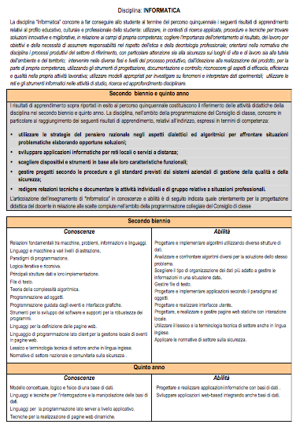
Subject Learning Outcomes

Slide 10
Thank you for your attention
Pierfranco Ravotto & Francesca Alfano
p.ravotto@aicanet.it francesca.alfano@icanet.it

