Slide 1
Consultation with VET stakeholders
OpenQAsS
Mary Cleary
29th March, 2017

Slide 2
Quality Assurance in VET
Erasmus + project designed to improve the teaching and learning in schools
Review of available existing documents:
Cedefop….
Qualification and Quality Ireland, other EU country QA authorities
ECDL Foundation Quality Assurance Procedures
EQAVET principles
Results of consultations in Italy and Hungary
Discussion
Notes:
Good morning, thank you for your time listening to me today explaining about an E+ project I have been engaged in for the last 18 months.
It is focussed on QA in FET and VET – VET is the key term in Europe and most closely relates to vocational and applied LC work and the FE sector.
The specific assumption is that the vocational education is tech focussed.
However, the issue of QA is important for all educators,
and therefore, as representatives of teachers and institute management across the school and FET sector in Ireland, I think it is appropriate that you are briefed about this work and if you are interested, given a chance to contribute to it.

Slide 3
EQAVET
EQAVET - (Framework for European Quality Assurance in Vocational Education and Training)
Respond to identified demands in the sector
Increasing attractiveness of VET, esp in technology
Embedding work-based learning & labour market relevance
Developing stronger career and education guidance
Relevant professional development for teachers
Improving recognition and transparency of VET learning outcomes between countries and across different education pathways”.
EQAVET recommends the nurturing of a quality culture
https://youtu.be/2HtvLbmw00M
Discussion
Notes:
Starting point is EQAVET, the Eur QA framework that legally underpins QA across all of Europe
Distinguish between VET and FET as well as recognise the overlaps, from Irish context
RATIONALE
Video…

Slide 4
EQAVET Indicators
1. Relevance of quality assurance systems for VET providers
2. Investment in training of teachers and trainers
3. Participation rate in VET programmes
4. Completion rate in VET programmes
5. Placement rate in VET programmes
6. Utilisation of acquired skills at the workplace
7. Unemployment rate
8. Prevalence of vulnerable groups
9. Mechanisms to identify training needs in the labour market
10. Schemes used to promote better access to VET
Discussion
Notes:
Are these the measures taken routinely in your school/college?
How closely do you monitor the activities of students after they leave?
Would this influence how you manage your programmes?

Slide 5
Process
Discussion
Notes:
EQAVET can help to make key decisions:
Consider all stakeholder, not just the student
Data protection
Goals that suit students, and the mission and values of the institution
Then, what indicators to measure success and quality?
How will this be documented?
What data and what schedule of data collection?
Who analyses it? What comparison should be made?
Bringing together the outcomes and the objectives – what is the final picture, can it lead to renewal and improvement?
What next – is there a step-up that can be aspired to?
Remember this is the key focus – the quality cycle

Slide 6
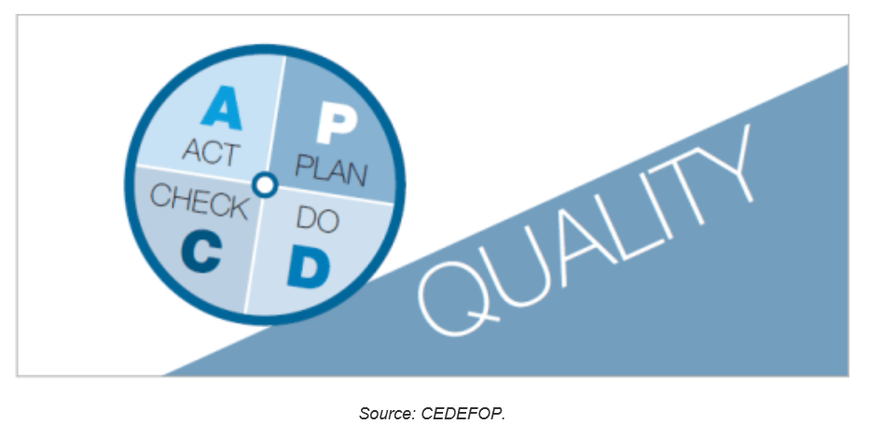
The Quality Cycle
Discussion
Notes:
The principle of the quality cycle is easy to understand, because it applies instinctively in everyday life. However, it is the systematic, continuous and regular use of the cycle that makes the difference when establishing a quality framework

Slide 7
Quality Process
Discussion
Notes:
mission statement and quality policy of the VET institution;
descriptions of the main processes and definitions of related (personal) responsibilities;
tools and instruments used for assessment and evaluation;
records of assessments and evaluations undertaken;
records of all suggestions, complaints and subsequent investigations made;
minutes and results of discussions to improve quality of organisational processes and programme and service delivery;

Slide 8
Components
Interactive Manual https://goo.gl/CH6St7
Toolkit - http://eqos.itstudy.hu/
Course and Certification – under development
http://openqass.itstudy.hu/en/IQAM
Any volunteers to adapt course for Ireland?
Discussion, Questions and Feedback
Notes:
Learning outcome
IQAM course enables the candidates to lead and manage all aspects of the quality assurance process of their organisation.
The participants will be able to lead the quality team and to manage planning, building and running quality management system of the VET institute.
They will be able to apply methods and tools to collect and analyse data for measuring the quality indicator as well as for monitoring, assessing and evaluating the QA processes based on the PLAN-DO-CHECK-ACT quality cycle.
Ask to volunteer for course adaptation for Ireland

